Slide 1
Apache Spark With Python Introduction
Study Notes prepared by Ram Sundaravel, June 2018
Contents are referenced from pluralsight course

Slide 2
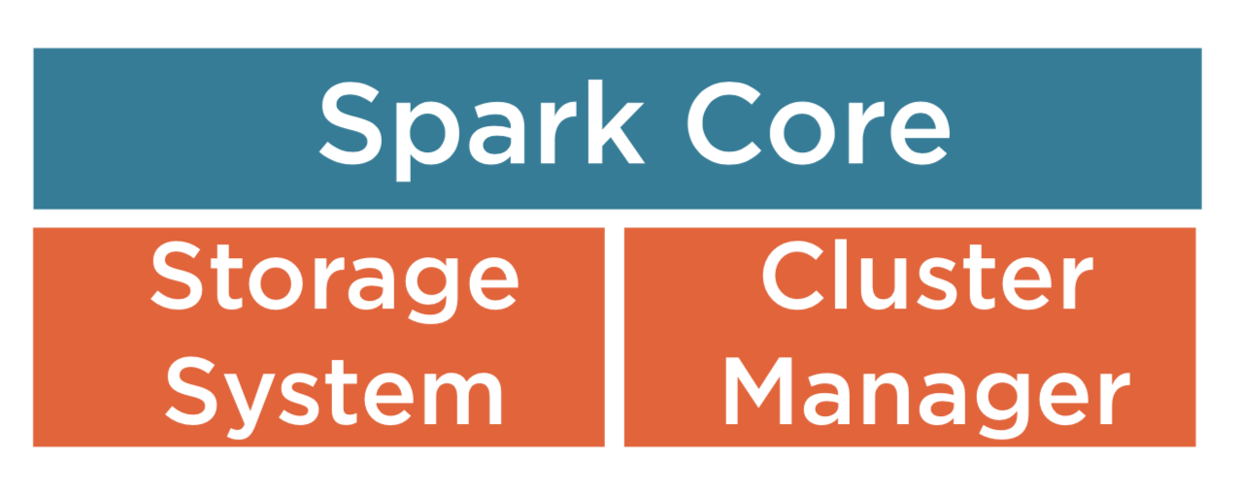
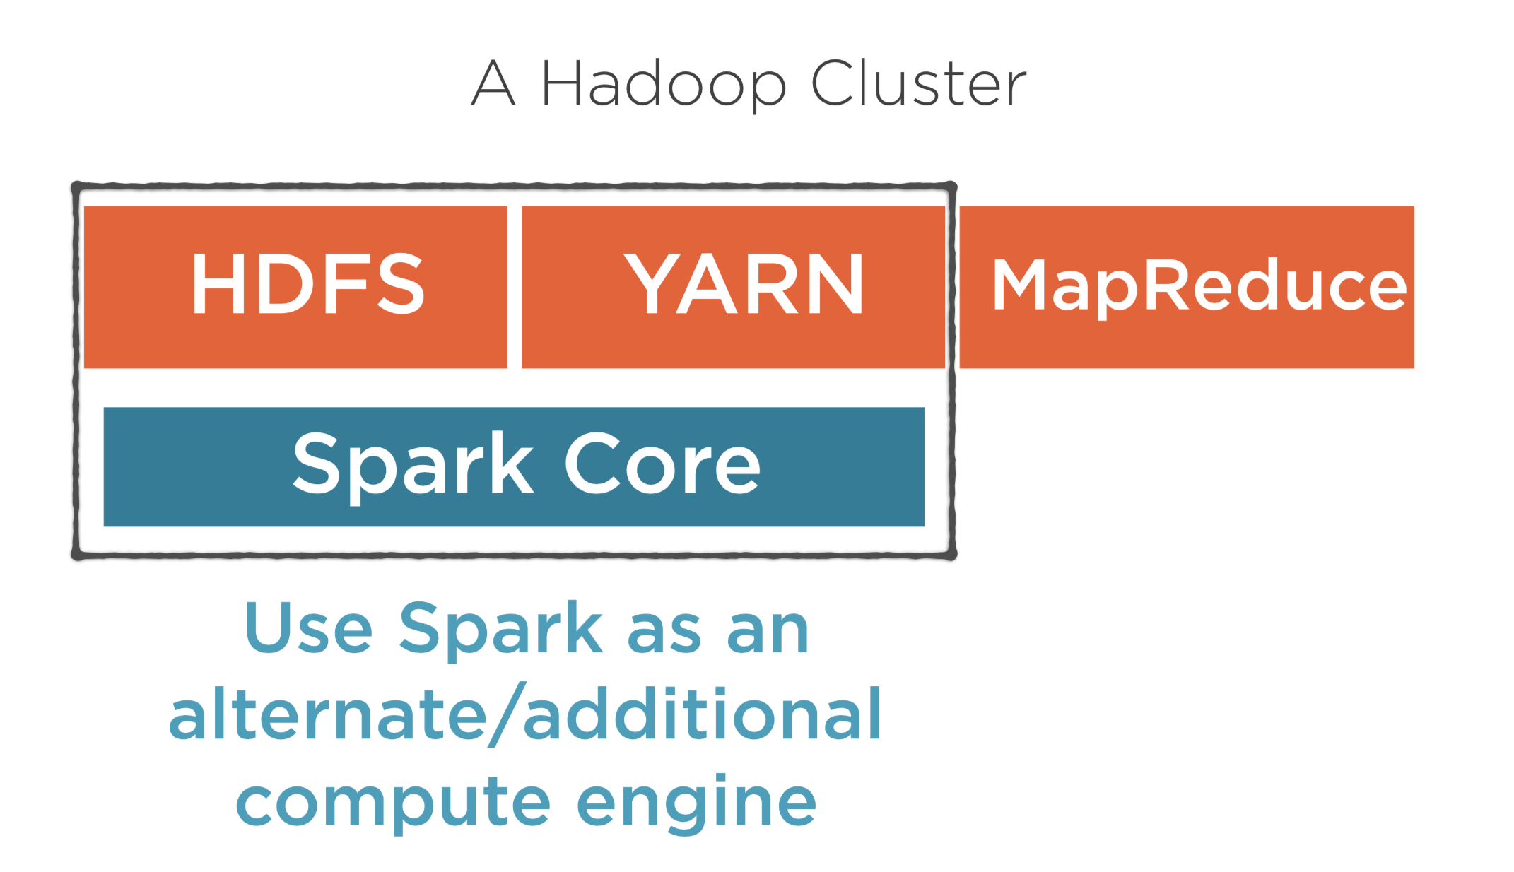
What is Spark?
An engine for data processing and analysis
Fast and Expressive Cluster Computing System Compatible with Apache Hadoop
Runs on Distributed computing
Upto to 100 x in memory and 10x faster on disk, 2 – 5 x less code
In Memory storage, Rich in APIs in Java, Scala, Python
Spark Components
Spark is just a computing engine.
Spark Components Explained
Spark Core - Computing engine, basic functionality of Spark Core is RDD(Resilient Distributed Dataset)
Storage – Storage system that stores data to be processed (Local file systems or HDFS)
Cluster Manager – Help Spark run tasks across a cluster of machines ( Built In cluster Manager or YARN)

Slide 3
Ambari
1. Web Management Console to monitor cluster resources
Spark Context
Pyspark interactive shell and memory management
pyspark --master yarn \
--num-executors 4 \
--executor-memory 2G \
--executor-cores 2 \
--conf spark.ui.port=34568
Then open tracking url and verify environment setup
Verify the number of executors
Driver and workers differentiation
Memory management

Slide 4
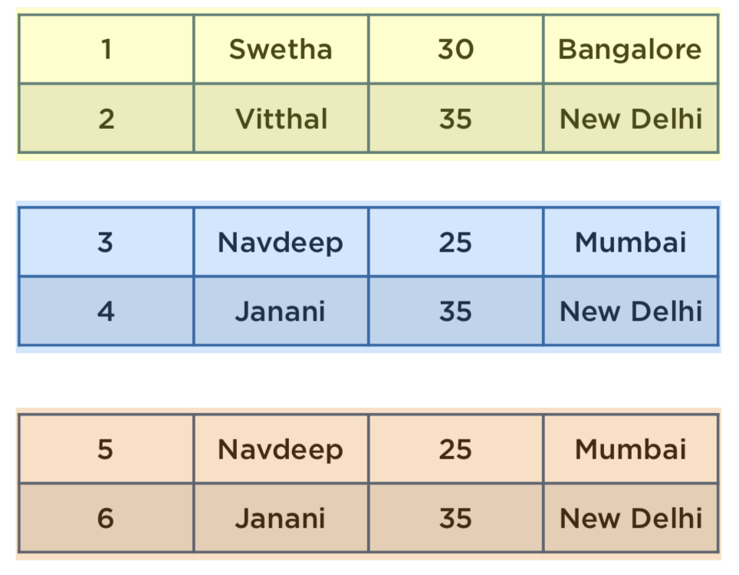
RDD
Properties of RDD
RDD Looks like
Resilient Distributed dataset
Important abstraction in spark
In memory collection of objects
Interact and play with billions of rows
Data from source gets load into in memory and corresponding object name is RDD
Partitions
Read Only
Lineage
Partitions:
Divided into partitions
Distributed to multiple machine called Nodes
Each node can process data individually for parallel processing

Slide 5
Read Only
Immutable
Only Two types of Operations
Transformations
Actions
Transformations: (Change of Actions)
Trnsfm1 : Load data from csv
Trnsfm2 : Pick only the third column
Trnsfm3 : Sort the Values
Wait Until a result is requested before executing any of these transformations
Actions : Requesting result
First 10 rows
A Count
A sum
Data is processed only when the user requests a result
Chain of transformations defined earlier
This can be explained further in Lineage
Dataset loaded in RDD

Slide 6
Lineage
RDD holds only metadata
It’s Parent RDD
Metadata
Every RDD knows where it came from
Lineage can be tracked back all the way to the source
When an action is requested on an RDD, all its parent RDDs are materialized.
Also called as LAZY EVALUATION

Slide 7
Demo

